Slide 1
Job Order Contracting (JOC) Program
December 16 – Pre-Bid Meeting 9:00 AM

Slide 2
About the Dormitory Authority of the State of New York
DASNY is New York State's public finance and construction authority. DASNY finances, designs, and builds health and education infrastructure that is the foundation of inclusive, sustainable communities.
Finance, Design & Construction
Health, higher education and public infrastructure
75+ Years of Building New York State
One of its most prominent public builders
Completed more than 1,000 projects since our inception
Offer a wide array of Construction and Construction Related Services

Slide 3


What is a Job Order Contract (JOC)?
ONE MASTER (UMBRELLA) CONTRACT, MANY PROJECTS
JOC provides a master, multi-year contract for a wide range of maintenance, repair and minor construction projects.
By winning the master contract once, you secure a potential pipeline of work (Job Orders) without the uncertainty and delay of repeated individual project bidding.
LONG-TERM PARTNERSHIP
1 Year with multiple renewal options.
Focus less on bidding, more on building.

Slide 4
Master Contract Regions & Trades
Regions: 10 regions throughout New York
Contract Types: 5 types in each region
General Construction
Mechanical
Electrical
Plumbing
Asbestos & HAZMAT Abatement
DASNY's JOC REGIONS
Region | Counties Included
1 | New York (Manhattan), Bronx, Kings (Brooklyn), Richmond (Staten Island), and Queens
2 | Nassau, and Suffolk
3 | Westchester, Rockland, and Putnam
4 | Orange, Sullivan, Delaware, Ulster, Dutchess, Greene, and Columbia
5 | Rensselaer, Albany, Schenectady, Otsego, Schoharie, Fulton, Montgomery, Saratoga, Washington, Warren, Hamilton, and Herkimer
6 | Essex, Clinton, and Franklin
7 | Lewis, Jefferson, and St. Lawrence
8 | Broome, Tioga, Tompkins, Cortland, Chenango, Cayuga, Onondaga, Madison, and Oswego
9 | Monroe, Wayne, Livingston, Ontario, Seneca, Yates, Steuben, Schuyler, and Chemung
10 | Niagara, Orleans, Genesee, Erie, Wyoming, Chautauqua, Allegany, and Cattaraugus

Slide 5
How You Bid: The Adjustment Factor
You’re NOT bidding on the cost of a specific job. You’re bidding an Adjustment Factor
Construction Task Catalog (CTC):
Catalog of pre-priced tasks on thousands of direct costs – LM&E
Price out all tasks included in the scope and then apply your bid factor
Adjustment Factor:
See “Using the Construction Task Catalog”
Calculation:
(Unit of Measure x CTC Task) x (Your Adjustment Factor) = Your Price
Example:
Price for an individual task in the CTC = $100.00
Scenario 1:
Your Adjustment Factor = 1.1000
$100.00 x 1.1000 = $110.00
Scenario 2:
Your Adjustment Factor = 0.9500
$100.00 x 0.9500 = $95.00
By applying your Adjustment Factor to the CTC prices, you’re essentially saying, “this is how much I need to be paid for these tasks to make a profit.”

Slide 6



The Foundation: Construction Task Catalog (CTC)
CATALOG
A catalog of fixed prices for labor, material and equipment costs for thousands of common construction tasks
COSTS INCLUDED
The CTC price covers direct costs (material, labor, equipment). It does NOT include your overhead and profit.
YOUR PROFIT CENTER
See “Using the Construction Task Catalog” to understand what the Adjustment Factor covers.
**Review the CTC carefully** to ensure you understand the direct cost baseline before submitting a bid.
You may find this article published by Gordian in 2022 helpful: How to Calculate a JOC Adjustment Factor

Slide 7
Awarded Master Contracts: The JOC Project Workflow
1
2
3
4
5
JOINT SCOPE MEETING
You meet with our team and all stakeholders on site to review the project.
DEVELOP SCOPE & RFP
What you’ll use to build a Price Proposal.
PROPOSAL
You use the CTC and your awarded Adjustment Factor to generate a precise line-item Price Proposal.
REVIEW & APPROVAL
Our team reviews the line items for accuracy and completeness. Fast approval process.
JOB ORDER ISSUED
If approved, the Job Order is issued, and you can mobilize and start construction immediately.

Slide 8

Additional Items to Consider
Project Labor Agreements (PLA): Required for all contracts in regions 1-3
Participation Goals: Each contract has assigned M/WBE, SDVOB and EEO goals
Applicable over the term of the contract
Reminder:
$0.00 Minimum Contact Value
Volume of projects vary year-to-year
Contractors must be experts in their trade and capable of managing multiple projects

Slide 9
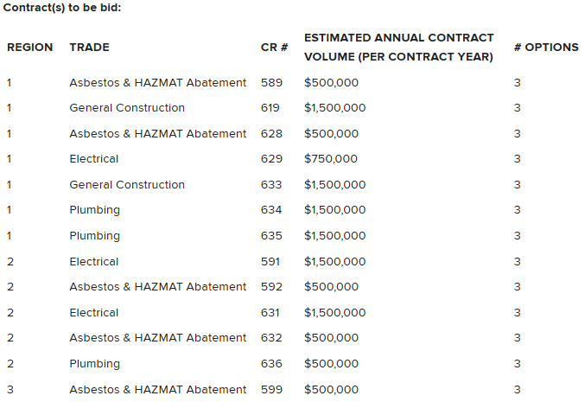
The Solicitation: The Master Agreements
Master Contracts: 13 Contracts across regions 1-3
PLA applies to regions 1-3
4 Different trades
RFI due date: 1/10/26 at 2PM
Bid due date: 1/20/26 at 2PM
Contract Documents: All Contract Documents are available on our website
https://www.dasny.org/opportunities/rfps-bids/2025/job-order-contracting-regions-1-2-and-3

