Slide 1
General Construction – Community Minor Maintenance Program (GC-CMM)
March 11, 2025

Slide 2
Agenda
About DASNY
Overview of the program
Regional Map and Counties
Questions
Solicitation

Slide 3
March 11, 2025
About DASNY Construction
New York State's public finance and construction authority
75+ Years of Building New York State
Completed 1000+ projects since its inception
Clients: public and private colleges, hospitals, primary care facilities, psychiatric centers, laboratories, etc.

Slide 4
March 11, 2025
Community Minor Maintenance (CMM)
Established in 2011 for smaller construction projects
Single scope of work ranging from $10,000 – $80,000
Work may entail:
  Roof replacement
  Driveway replacement
  Renovations or replacement of exterior decks, windows, stairways, and entrances
  Interior renovations such as kitchen and bathroom rehabilitation
  Painting and flooring replacement

Slide 5
March 11, 2025
What’s the advantage of the CMM program?
Fast delivery method for construction projects
Awarded a regional contract based on an agreed upon mark-up
More cost-effective method of managing and supervising the work
The mark-up covers the cost of supervising, coordinating, overhead, profit and insurances
Term construction contract

Slide 6
March 11, 2025
How CMM works:
Obtain a minimum of three (3) price proposals
Base term: two (2) years
Written approval is required before self-performing any work
All work must be subcontracted unless otherwise approved by DASNY
One (1 )Option, and the term is two (2) years

Slide 7
March 11, 2025
Minimum value & GC’s required services
Estimated Annual Contract Volume (EACV) = $150,000
The Minimum Contract Value = $0
Services provided by the General Contractor for each Work Order include, but are not limited to:
Investigation and Planning
Bidding and Pre-Construction
Construction Management
Supervision and Coordination
Close-out

Slide 8
March 11, 2025
Work Order Process
Client
DASNY
Contractor to engage Subcontractors
DASNY to review & issue Work Order
Site visit
Subcontractor proposals
Contractor to provide Subcontractor proposals and recommendation

Slide 9
March 11, 2025
Form of Bid & Multiplier/Mark-up
One (1) bid per region
Mark-up percentage covers GC’s cost for:
  Managing, supervising and coordinating the work
  Overhead and profit
  Insurances
The contractor applies the mark-up to any Subcontractor performing work on the project
Individual Work Orders cannot exceed $80,000 excluding the GC’s multiplier/mark-up

Slide 10
March 11, 2025
MWBE & SDVOB participation goals
MBE
18%
WBE
12%
SDVOB
6%
EEO
10% Upstate
45% Downstate
Must achieve the required MWBE & SDVOB participation goals over the term of their contract

Slide 11
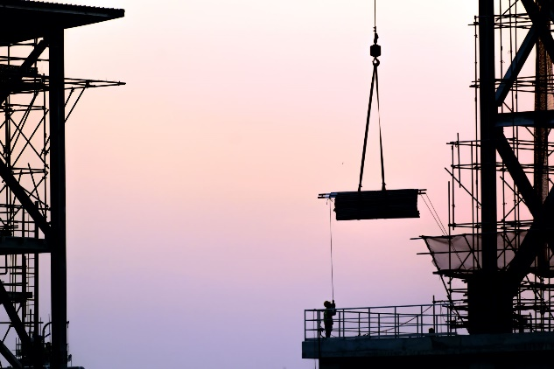
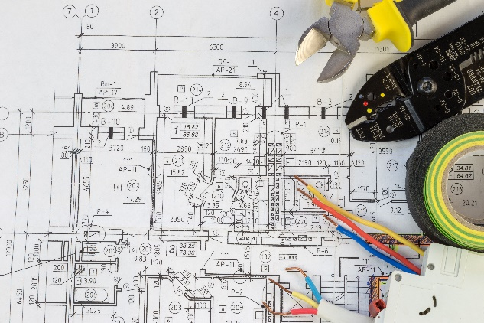
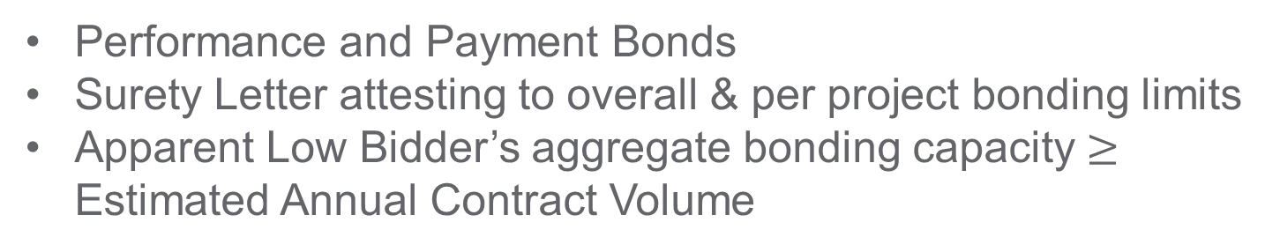
Bonding Requirements
Performance and Payment Bonds
Surety Letter attesting to overall & per project bonding limits
Apparent Low Bidder’s aggregate bonding capacity $≥$ Estimated Annual Contract Volume

Slide 12
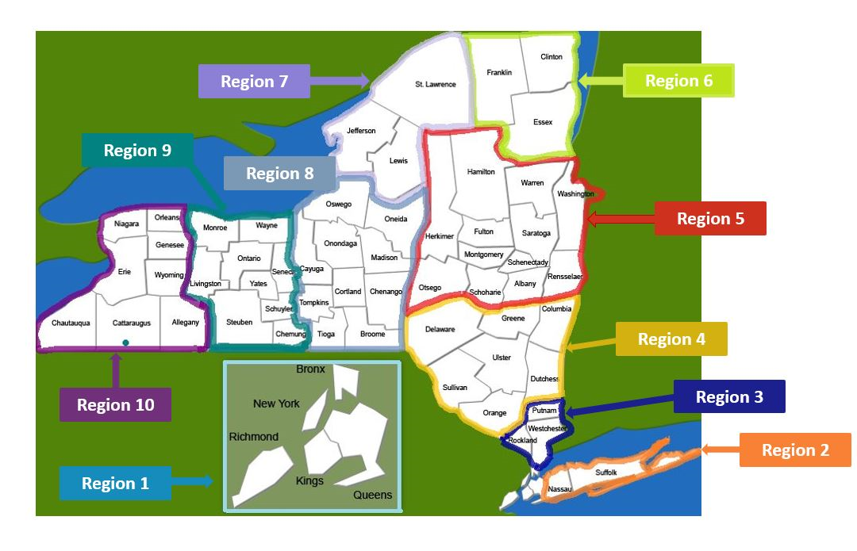
March 11, 2025
Regional Map

Slide 13
Solicitation
REGION (S) | TRADE | ESTIMATED ANNUAL CONTRACT VOLUME (PER CONTRACT YEAR) | # OPTIONS
1 | General Construction | $150,000.00 | 1
2 | General Construction | $150,000.00 | 1
3 | General Construction | $150,000.00 | 1
4 | General Construction | $150,000.00 | 1
5 | General Construction | $150,000.00 | 1
6 | General Construction | $150,000.00 | 1
7 | General Construction | $150,000.00 | 1
8 | General Construction | $150,000.00 | 1
9 | General Construction | $150,000.00 | 1
10 | General Construction | $150,000.00 | 1

Slide 14
March 11, 2025
Questions?
ccontracts@dasny.org

