Slide 1
Dormitory Authority
of the
State of New York
We Finance, Design & Build New York's Future

Slide 2
Agenda
About DASNY
Job Order Contracting Program
Opportunity Programs Requirements
Contracting Regions
Western Solicitations
Schedule of Events
Next Steps
Questions

Slide 3
About DASNY Construction
DASNY is New York State's public finance and construction authority.
DASNY’s Job Order Contracting Program is one of the many procurement methods available to provide these services.
Offer flexibility to execute projects quickly.

Slide 4
JOC Program Overview
Base term of one (1) year and three (3) one (1) year option periods – Potentially a four (4) year contract.
Award multiple contracts in 10 regions to provide coverage throughout the State.
Contactors must be experts in their trade and have the capacity to manage multiple projects simultaneously.

Slide 5
JOC Program Overview
The Minimum Contract Value = $0.
The Contractor is not guaranteed to receive the Estimated Annual Contract Volume (as noted in upcoming slides).

Slide 6
CTC & Adjustment Factors
Adjustment Factors
Construction Task Catalogue (CTC)
Unit Price x Quantity x Adjustment Factor = Total for Task
The CTC is updated and distributed on an annual basis.

Slide 7
Contract Execution Requirements
Minimum Qualifications Form
Insurance
New York State Vendor Responsibility Questionnaire
Agreement
Surety Letter

Slide 8
Opportunity Programs Requirements
REGION | TRADE | CR# | MBE % | WBE % | SDVOB % | EEO%
9 | Electrical | 611 | 18% | 12% | 6% | 10%
9 | Plumbing | 612 | 18% | 12% | 6% | 10%
9 | Asbestos & HAZMAT Abatement | 613 | 18% | 12% | 6% | 10%
10 | Electrical | 614 | 18% | 12% | 6% | 15%
10 | HVAC | 615 | 18% | 12% | 6% | 15%
10 | Plumbing | 616 | 18% | 12% | 6% | 15%
10 | Asbestos & HAZMAT Abatement | 617 | 18% | 12% | 6% | 15%

Slide 9
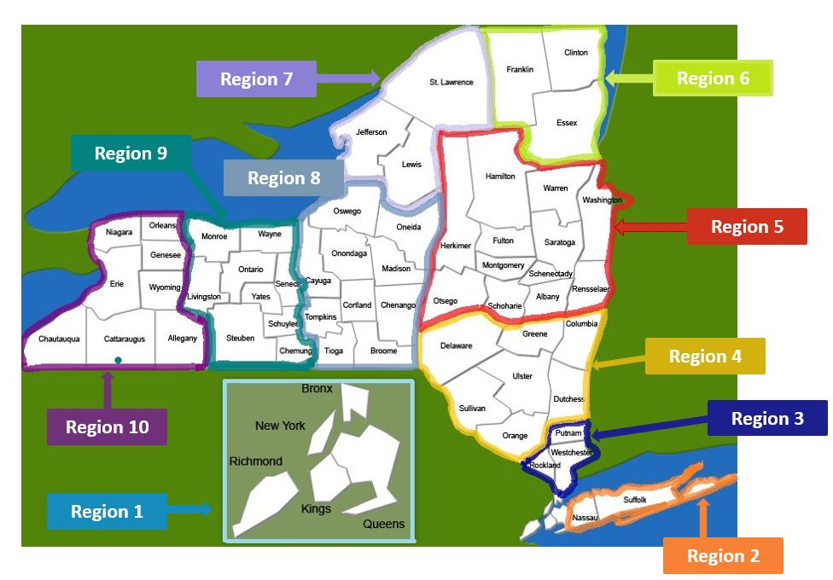
DASNY’s Job Order Contracting Regions
DASNY's JOC REGIONS
Region | Counties Included
1 | New York (Manhattan), Bronx, Kings (Brooklyn), Richmond (Staten Island), and Queens
2 | Nassau, and Suffolk
3 | Westchester, Rockland, and Putnam
4 | Orange, Sullivan, Delaware, Ulster, Dutchess, Greene, and Columbia
5 | Rensselaer, Albany, Schenectady, Otsego, Schoharie, Fulton, Montgomery, Saratoga, Washington, Warren, Hamilton, and Herkimer
6 | Essex, Clinton, and Franklin
7 | Lewis, Jefferson, and St. Lawrence
8 | Broome, Tioga, Tompkins, Cortland, Chenango, Cayuga, Onondaga, Madison, and Oswego
9 | Monroe, Wayne, Livingston, Ontario, Seneca, Yates, Steuben, Schuyler, and Chemung
10 | Niagara, Orleans, Genesee, Erie, Wyoming, Chautauqua, Allegany, and Cattaraugus

Slide 10
Western Solicitation
DASNY is soliciting the following Bids:
Western | Estimated Annual Contract Volume
Region 9 Electrical | $500,000
Region 9 Plumbing | $500,000
Region 9 Asbestos & HAZMAT Abatement | $500,000
Region 10 Electrical | $500,000
Region 10 HVAC | $500,000
Region 10 Plumbing | $500,000
Region 10 Asbestos & HAZMA Abatement | $500,000

Slide 11
Schedule of Events
DASNY's Schedule
Date | Event
6/20/2024 | Advertise Contracts (all regions)
7/10/2024 at 10:00 AM | Pre-Bid Meeting for Prospective Bidders held via Zoom (Western)
8/25/2024 at 2:00 PM | Western RFIs due
9/4/2024 at 2:00 PM | Western bids received by, opened, and read aloud

Slide 12
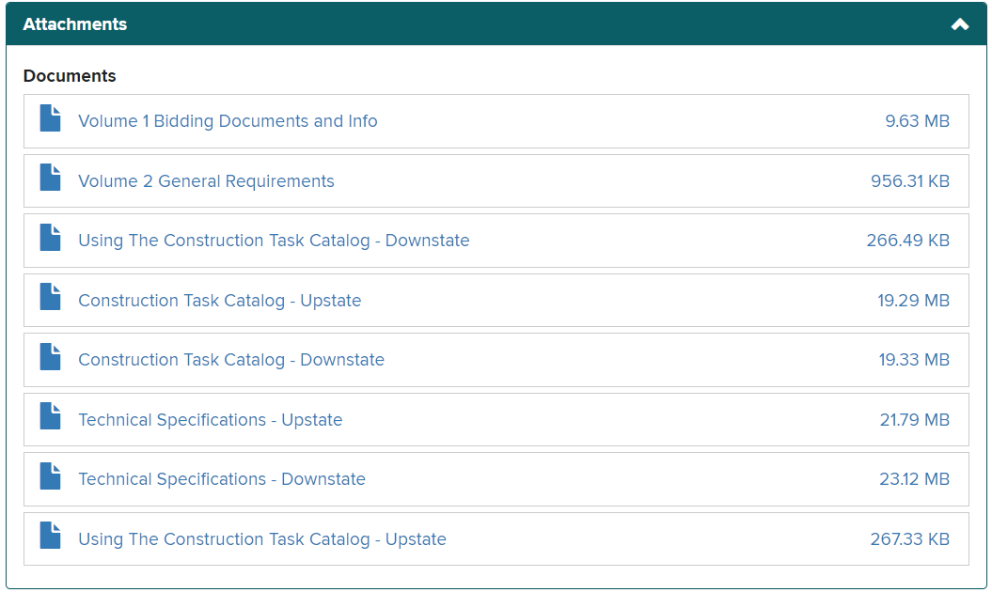
Next Steps
Volume I Bidding Documents
and Info
Notice to Bidders
Information for Bidders
Form of Bid
Agreement & Bonds (drafts)
General Conditions
Using The Construction Task Catalog

Slide 13
Questions?

