Slide 1
DASNY JOC Program – New Contract Solicitations
Pre-Bid Conference
October 21, 2020 (Via WebEx) – 10:00 AM

Slide 2
AGENDA
DASNY Overview - Job Order Contracting Program
Explanation of Job Order Contracting
Current Contract Solicitations
Understanding the Construction Task Catalog (CTC)
Formula for Calculating the Price Proposal
Calculating the Adjustment Factors
Bid Considerations
MWBE and SDVOB Participation
Review of Key Points
Question & Answer Session

Slide 3
DASNY Overview – Job Order Contracting Program
DASNY is New York State’s Developer
DASNY is among the nation’s largest issuers of low-cost, tax-exempt bonds and one of its biggest public builders.
We finance and construct facilities for:
  Colleges and Universities
  Health-care Providers
  Government Agencies and Authorities
  Non-Profit Organizations

Slide 4
DASNY Overview – Job Order Contracting Program
Job Order Contracting or JOC is a type of procurement designed to provide faster contracting time to speed project delivery.
DASNY’s JOC Program is used for a range of projects such as:
  small- to medium-size renovation and repair projects
  emergency work to address hazardous conditions
  urgent projects to correct conditions that impact the use and occupancy
  completing punch list work
  probes and other exploratory work
In 2019 DASNY executed work valued at $64 million through the JOC Program

Slide 5
DASNY Overview – Job Order Contracting Program
DASNY’s JOC program is a competitive procurement method whereby DASNY awards term contracts in 10 Regions for:
General Construction, Mechanical, Plumbing, Electrical, Hazmat & Roofing.
JOC contractors provide construction services statewide using a Catalog of fixed unit prices that are adjusted by Contractor-Specific Adjustment Factors.
The value of an average DASNY JOC Program project is approximately $150,000, but project values can range from a few thousand dollars to over $1 million.

Slide 6
DASNY Overview – Job Order Contracting Program
DASNY awards contracts that have a one-year base term and three one-year renewal options.
Prime contractors in DASNY’s JOC Program must be bondable and must submit a letter from their Surety with their bid attesting to their aggregate and per project bonding limits
DASNY is committed to diversity in all its procurements. The JOC Program offers opportunities for MWBE and SDVOB firms as Primes, Subcontractors & Suppliers.

Slide 7
DASNY Overview – Job Order Contracting Program
Firms interested in DASNY’s JOC Program do not need to be experts in Job Order Contracting or eGordian Software. Firms awarded JOC contracts will receive ongoing personalized training by Gordian, DASNY’s Job Order Contracting Consultant.
Firms interested in DASNY’s JOC Program must be experts in their trade, have strong back-office infrastructure, and the capacity to manage multiple projects simultaneously.
A Firm’s performance determines if it will continue to receive work.

Slide 8
DASNY Overview – Job Order Contracting Program
DASNY is committed to working with firms already active in our JOC Program as well as to attract new and diverse firms to the program.
Please use the Chat function in this WebEx presentation to provide the following information for your firm.
    Name, location and email address
    Trade specialization
    Trade contract you are interested in bidding
    Is your firm a NYS-certified MWBE or SDVOB?
    Is your firm currently a DASNY JOC contractor?

Slide 9
EXPLANATION OF JOB ORDER CONTRACTING
Job Order Contracting Provides:
  The Ability to Accomplish a Substantial Number of Individual Projects with a Single Competitively Bid Contract
  On-Call Contractors Ready to Perform a Series of Projects at Different Locations for Competitively Bid Prices
Introduced In the United States in 1985
  DOT, USPS, NASA, HUD
Over 1,100 Job Order Contracts In Use

Slide 10
EXPLANATION OF JOB ORDER CONTRACTING
Over $2 Billion of Construction Placed Annually
Implemented By Major Cities, Counties, Public Agencies
  Dormitory Authority of the State of New York
  State University Construction Fund
  NYS Department of Transportation
  NYS Department of Environmental Conservation
  NYS Office of General Services
  New York City Department of Education

Slide 11
EXPLANATION OF JOB ORDER CONTRACTING
Faster
  In JOC work can start between 75-85% faster than traditional contracting methods. Days or weeks instead of months. Since the JOC Contractor is already under contract and on-call, DASNY avoids the traditional procurement time.
Better Quality
  Since the structure of JOC is a series of individual Job Orders, the JOC Contractor has an ongoing financial incentive to provide a quality project. If the JOC Contractor fails to maintain the desired level of service and quality, DASNY can elect to complete the projects using traditional contracts.
Less Expensive
  JOC can save between 8-15% in total costs over traditional contracting methods. These cost savings occur from reduced design costs, lower procurement costs, lower direct cost of construction, decreased overhead costs, and reduced post award claims.

Slide 12
EXPLANATION OF JOB ORDER CONTRACTING
Increased Contractual Control
  Each Job Order represents only a small portion of the total volume of work that the JOC Contractor could receive. The JOC Contractor has an incentive to perform to receive additional Job Orders.
Improved MWBE / SDVOB Participation
  JOC is a procurement system with the capacity to improve participation of MWBE & SDVOB firms. DASNY can elect not to give future Job Orders to a JOC Contractor that fails to make good faith efforts to meet DASNY’s MWBE / SDVOB Goals.

Slide 13
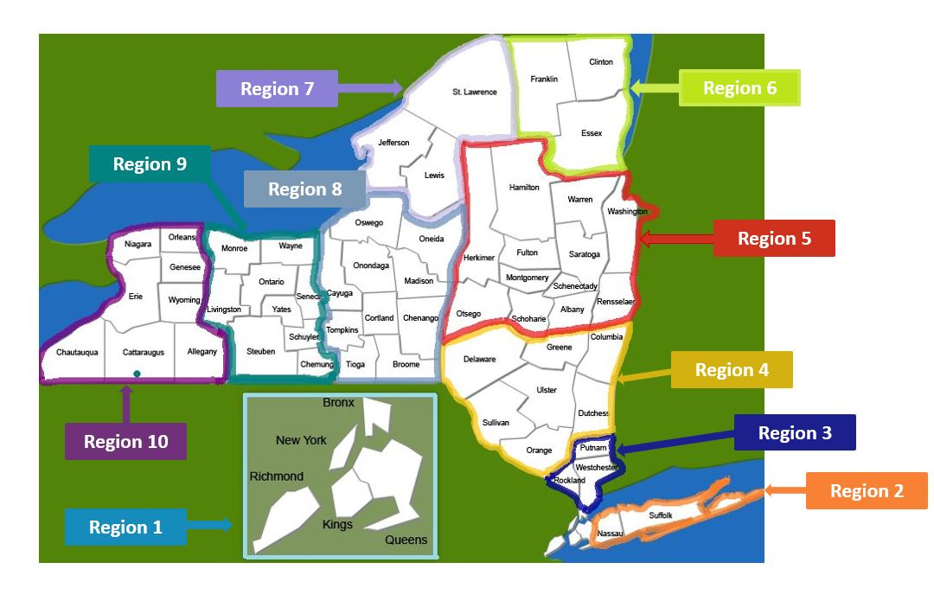
CURRENT SOLICITATIONS

Slide 14
CURRENT SOLICITATION
DASNY is procuring 10 new trade contracts in various regions statewide for its JOC Program including General Construction, HVAC, Plumbing and Asbestos / Hazmat Abatement.
Five contracts are Open-Market solicitations; any experienced and qualified bidder may respond.
Five contracts are solicitations under DASNY’ Small Business, Minority and Woman-Owned Enterprise Pilot Program; only experienced and qualified NYS-certified MWBE and SDVOB bidders may respond.

Slide 15
CURRENT SOLICITATION
Downstate
Region | CR # | Description | Bid Security | Maximum Contract Value
1 | 503 | General Construction | $ 25,000 | $6,000,000
1 | 506 | Mechanical | $ 25,000 | $2,500,000
2 | 504 | General Construction | $ 25,000 | $1,500,000
2 | 507 | Mechanical | $ 25,000 | $1,500,000
2 | 508 | Asbestos Abatement | $ 25,000 | $500,000

Slide 16
CURRENT SOLICITATIONS
Upstate / Western New York
Region | CR # | Description | Bid Security | Maximum Contract Value
3 | 505 | Plumbing | $ 25,000 | $5,000,000
5 & 6 | 509 | General Construction | $ 25,000 | $5,000,000
7 | 510 | General Construction | $ 25,000 | $3,000,000
10 | 511 | Electrical | $ 25,000 | $1,500,000
10 | 512 | General Construction | $ 25,000 | $5,000,000

Slide 17
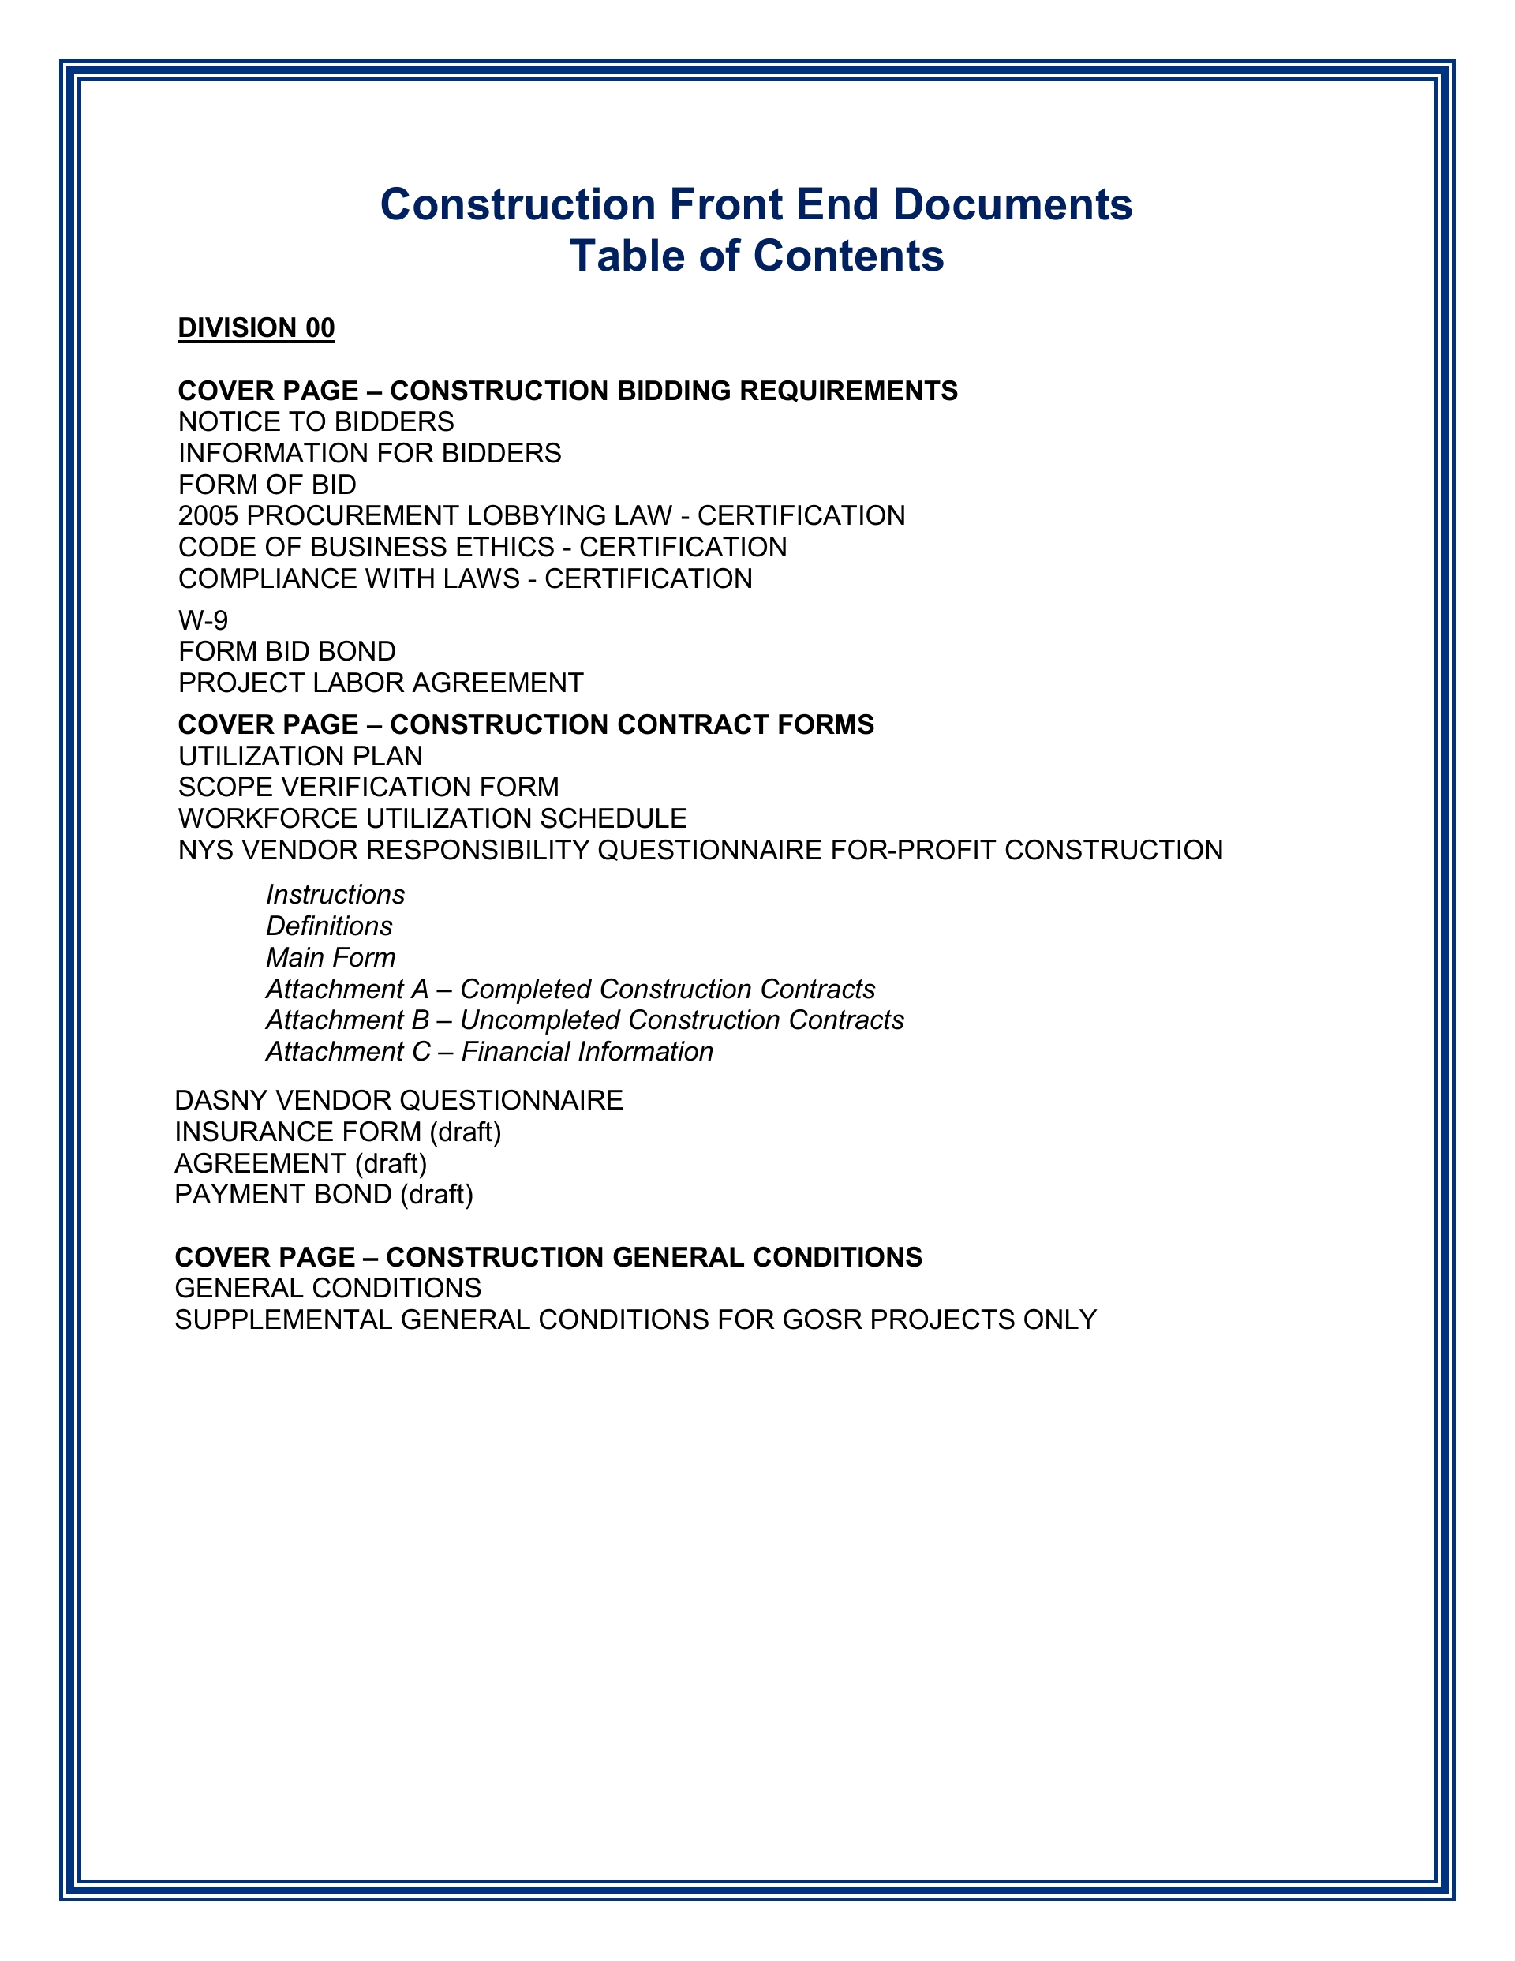
CURRENT SOLICITATIONS
Volume I
  Terms & Conditions
    New & Revised
  Information for Bidders
  Bid & Contract Forms
  Performance & Payment Bonds (per JO)
  General Conditions
  General Requirements
  Affirmative Action Forms

Slide 18
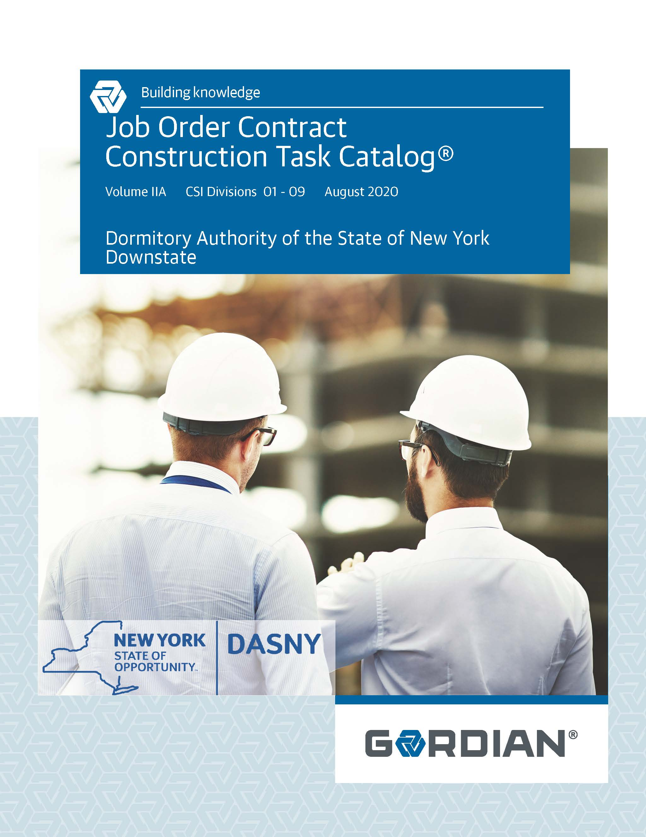
CURRENT SOLICITATIONS
Volume IIA & IIB
  Construction Task Catalogs
  Dated: August 2020
Catalog of Pre-Priced Construction Tasks
  Organized by CSI Master Format 2004
  Unit Prices Calculated using Local Labor, Material & Equipment Costs
  Customized for DASNY

Slide 19
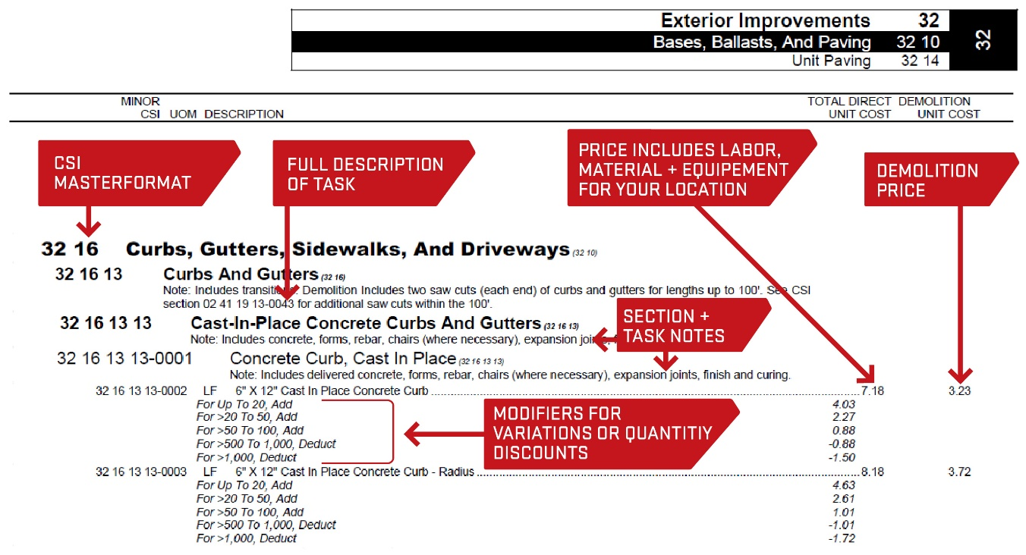
CURRENT SOLICITATIONS

Slide 20


CURRENT SOLICITATIONS
Volume IIIA, IIIB, IIIC, IIID & IIIE
  Technical Specifications
  Specifies Quality of Materials and Workmanship
Volume IV
  NYS DOL Wage Information

Slide 21
CURRENT SOLICITATIONS
Pre-Bid Guidance to Contractors
At the time of contract bidding DASNY Cannot:
  Identify or Commit to any specific Project or Locations (other than a Region)
  Identify or Commit to any specific Quantities, Tasks or Project Values
The JOC Contract has a Fixed Term with Option Periods
  Base Term = One Year or When Maximum Contract Value is Reached
  Three (3) one-year Options (By Mutual Agreement and based on performance)
The Base Term and each Option has a Maximum Contract Value.

Slide 22


CURRENT SOLICITATIONS
Bid Requirements
1
2
Competitive Bid
Must Bid Three Adjustment Factors – (5 Additional AF’s for PLA Work, See Below)
    Normal Working Hours
    Other Than Normal Working Hours
    Non Pre-Priced Work
  PLA - 5 AF’s (Region 1 ONLY)
    Day Shift Monday to Friday (as defined by the PLA)
    2nd Evening or 3rd Night Shift Monday to Friday (as defined by the PLA)
    Day Shift Saturday or Sunday (as defined by the PLA)
    2nd Evening or 3rd Night Shift Saturday or Sunday (as defined by the PLA)
    Holidays (as defined by the PLA)
  Same Adjustment Factors Apply to All Tasks in the CTC®
    Must Include all Indirect Costs & Profit
  Lowest Award Criteria From an Acceptable, Responsive, Responsible Bidder Wins!
WORK PERFORMED
DURING NORMAL
WORKING HOURS
WORK PERFORMED
DURING OTHER THAN
NORMAL WORKING HOURS
3
NON PREPRICED WORK
*PLA AF’s & WORK HOURS AS DEFINED BY THE PLA

Slide 23

CURRENT SOLICITATIONS
Joint Scope Meeting
  Develop Detailed Scope of Work
Issue Request for Proposal
Receive Price Proposal Package
  Price Proposal Summary
  Detailed Price Proposal
  Proposed Project Schedule
  MWBE and SDVOB Utilization Plan
  List of Proposed Subcontractor / Suppliers
  Any Required Submittals, Insurances, NPP Backup, etc.
JOC Contractor’s Price Proposal Package Reviewed and Approved
Issue Lump Sum Job Order

Slide 24
CURRENT SOLICITATIONS
Payment and Performance Bonds:
Submit Letter from Surety with your bid re: Aggregate and per Project Bond Limits
Revised Bonding Requirements. Bonds are required if:
1) the value a Job Order to be awarded is $100,000.00 or more, or
2) the cumulative value of a Job Order to be awarded plus the value of all previously
awarded Job Orders awarded under the Contract is $100,000.00 or more.
The Bond premium is a reimbursable cost that is included in the price proposal with no mark-up, i.e.: an adjustment factor of 1.0000.

Slide 25
CURRENT SOLICITATIONS
Adjustment Factors are Good for the Life of the of the Contract
  See General Conditions, Section 1A.04, Annual Update of the Construction Task Catalogs, D. & E.
Construction Task Catalogs updated annually and issued in August.
  See General Conditions, Section 1A.04, Annual Update of the Construction Task Catalogs, A.
Liquidated Damages
On a Job order basis

Slide 26
CURRENT SOLICITATIONS
Contractor is not Guaranteed to Receive any Minimum Amount of work or the Maximum Contract Value
Contractor has a Continuing Financial Incentive to Provide
  Responsive Services
  Quality Work
  Lower Cost
Future Job Orders Tied to JOC Contractor Performance
  No Obligation To Award Projects to JOC Contractors
  Additional JOC Contracts May Be Bid and Awarded if DASNY is Not Satisfied With JOC Contractor Performance

Slide 27
CURRENT SOLICITATIONS
Construction Task Catalog or CTC® is customized for DASNY
  Updated annually and issued to contractors in August
  DASNY Approved Products Specified
  Uses Local Prevailing Wage Rates
  Uses Local Material and Equipment Costs
Filings and Permits
  Many Projects Do Not Require Permits
  JOC Contractor to Obtain Permits When Required
  Fees Paid to Government for All Permits Reimbursed 100%

Slide 28
CURRENT SOLICITATIONS
Differing Site Conditions
  Treated as Additional Job Order(s)
Retainage
  5% (Released at Completion of Each Individual Project / Job Order)
No Substantial Completion (except for larger, more complex projects)
  JOC Projects are generally 100% Complete or Incomplete
One Payment for Projects Completed Within 45 Days or Costing $50,000 or Less - Monthly Progress Payments for other Job Orders

Slide 29
UNDERSTANDING THE CTC ®
  Review Section 00, pages 1 - 6 of the CTC, Understanding the CTC. It outlines what is included in unit prices and adjustment factors, general rules, or equals, etc.
  Key Points:
  Unit Prices are for Complete and In-Place Construction
  Unit Prices Include Direct costs of Labor, Material and Equipment. Do Not Add Labor.
  Unit Prices Include the Cost of Delivery to Project Site, Unloading, Storage and Handling. Delivery Height is up to 2 ½ Stories

Slide 30
UNDERSTANDING THE CTC ®
  Unit Prices Include Testing, Calibration, Balancing Etc. for New Work
  Unit Prices Include all Fasteners, Bolts, Anchors, Adhesives Etc. For New Work
  Unit Prices Include an Allowance for Waste – e.g. carpet, drywall, VCT, ceiling tile, etc.
  Demo Price Includes Loading into Truck or Dumpster.
  If Item Demolished as Part of Different Task, It will Not Be Paid for Separately

Slide 31
UNDERSTANDING THE CTC ®
  Contractor Paid for Installed Quantities Only, No Waste
  Assembly Prices take Precedence over Component Pricing
  14’ Working Height for All Work Except Masonry which is 4’
  Over those Heights, Contractor paid for Scaffolding, Scissor Lifts, etc.
  Dumpsters are a Separate Item

Slide 32
UNDERSTANDING THE CTC ®
Mobilization Task for Excavation Equipment, Paving Equipment, Cranes, etc.
Minimum Set up Charges for Core Drilling, Saw Cutting, etc.
Minimum Charge for Small Area Pavement Repairs
Paid Separately for Removing Demolition Material and Waste Material From Site
Modifiers for Small Quantities

Slide 33
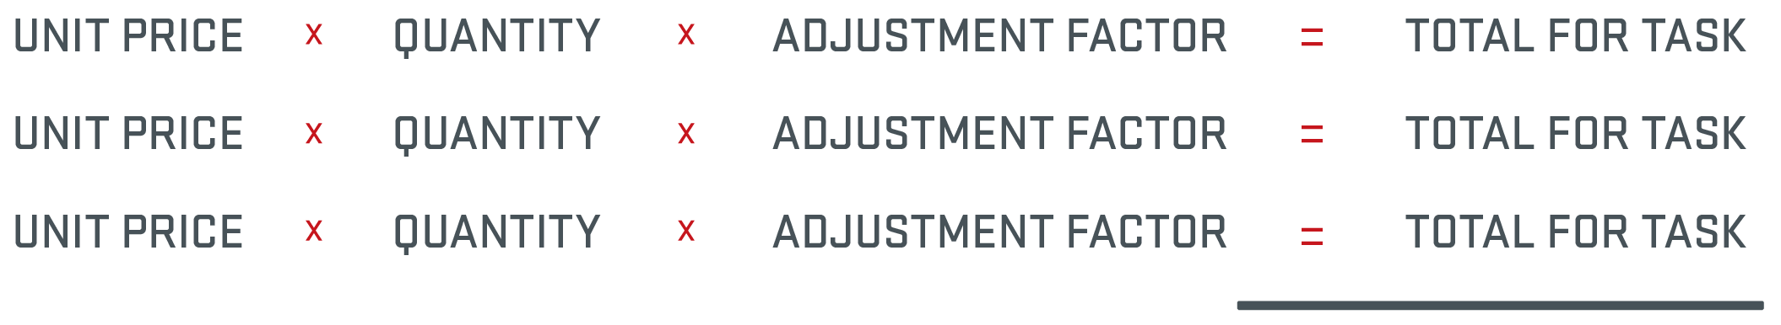
FORMULA FOR CALCULATING THE PRICE PROPOSAL
Total Job Order Amount
* Non Pre-Priced (NPP) Tasks are Calculated Separately

Slide 34
CALCULATING THE ADJUSTMENT FACTORS
1
Use Historical Project Data
2
Sampling Method
Select a Representative Completed Project
  You Know Scope and Direct Costs
Price Project from CTC®
Add on Overhead and Profit
Calculate the Adjustment Factors
Evaluate a Sampling of the Anticipated Items
Create a Representative Project
3
Create a Scope of Work
Get Sub Quotes or Estimate Cost
Price Project from CTC®
Add on Overhead and Profit
Calculate the Adjustment Factors

Slide 35
CALCULATING THE ADJUSTMENT FACTORS
Work at Administrative Building and Shop
  Doors and Hardware
    Replace 12 interior doors, hinges and hardware
    Doors shall be 3x7, solid core wood doors, Grade 2 locksets with knobs
    Replace 2 push bar exist devices and door closers on exit doors
  Interior Lighting
    Replace all lay-in troffer fixtures on first and second floors. 48 in total
    Replace 4 LED exit fixtures
    Replace 12 industrial fixtures in shop area
  Plumbing Fixtures
    Replace 8 bathroom sinks, 8 faucets, and 8 toilets in men’s and women’s bathroom in admin building and shop area
    Replace 4 water fountains
  Replace Boiler
    Demo existing boiler and as much piping and venting to accommodate new boiler. Install a new 1028 mbh oil-fired cast iron boiler. Weil-McLain Model 88. No access for packaged boiler. Must field assemble sections. Provide new piping as required.

Slide 36
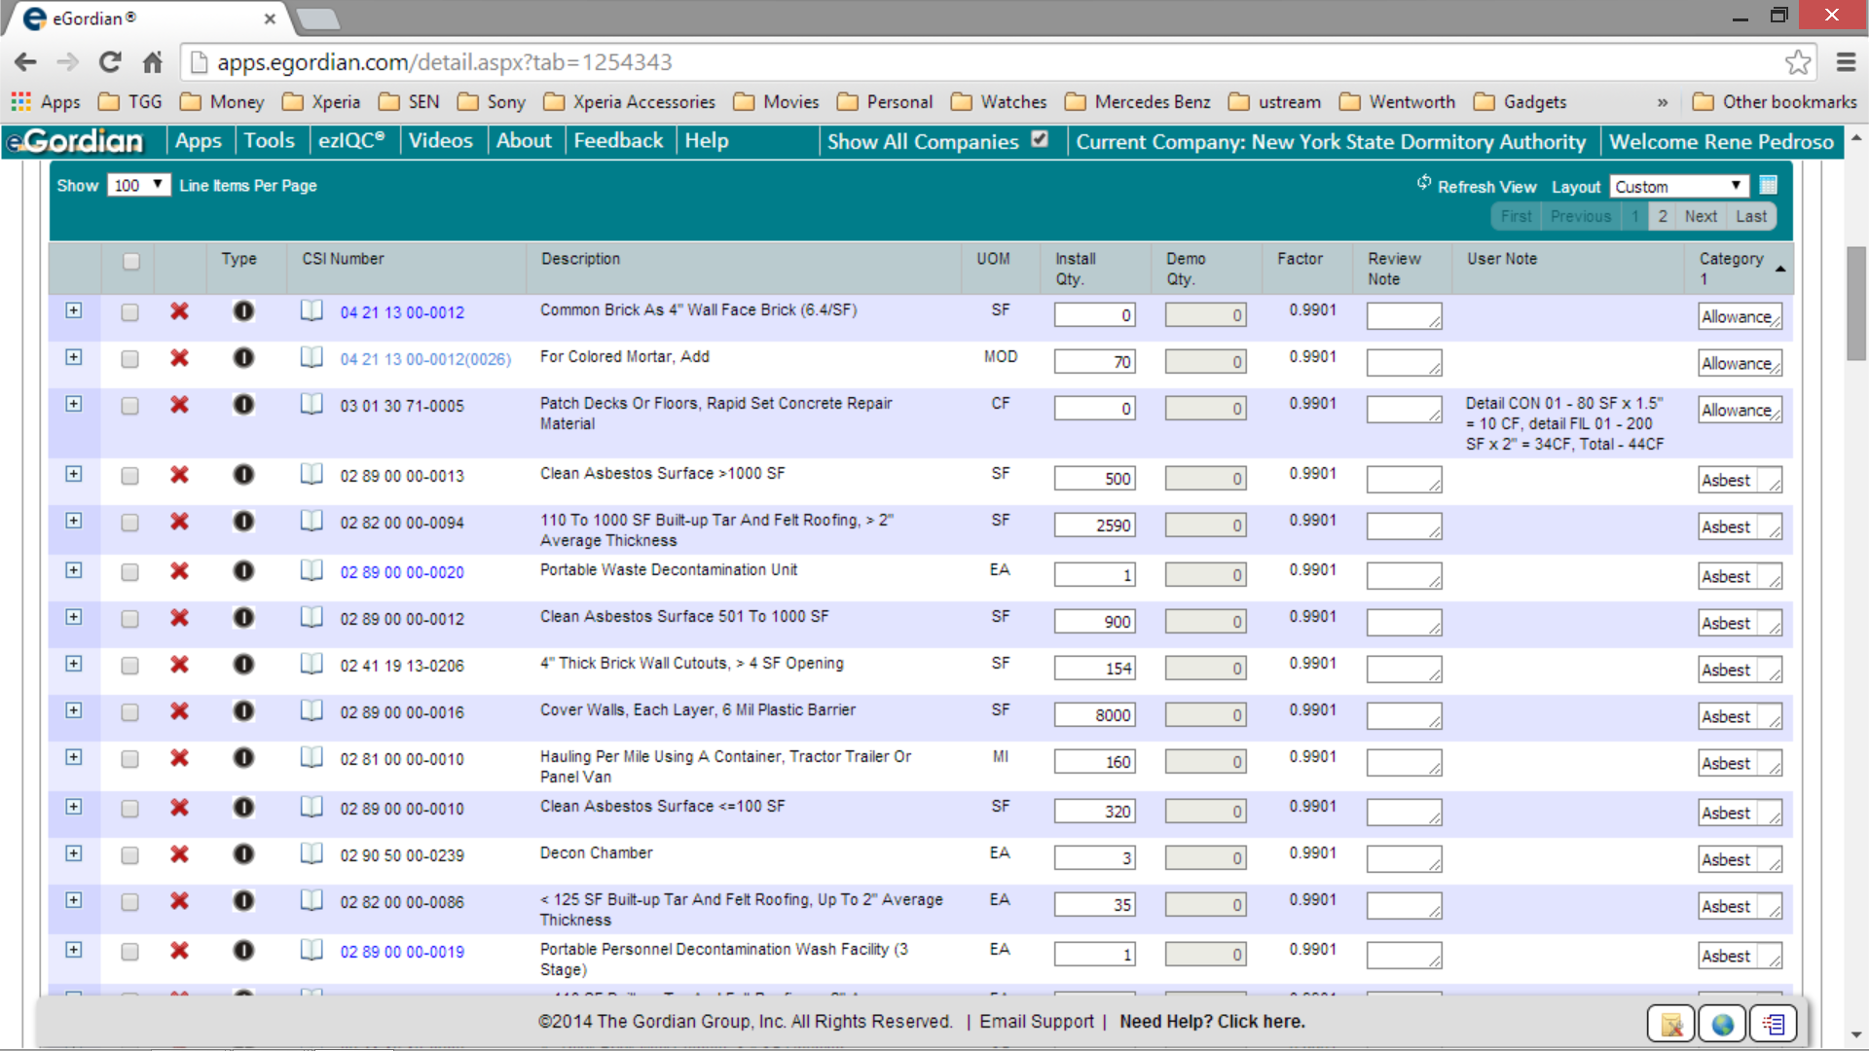
CALCULATING THE ADJUSTMENT FACTORS

Slide 37
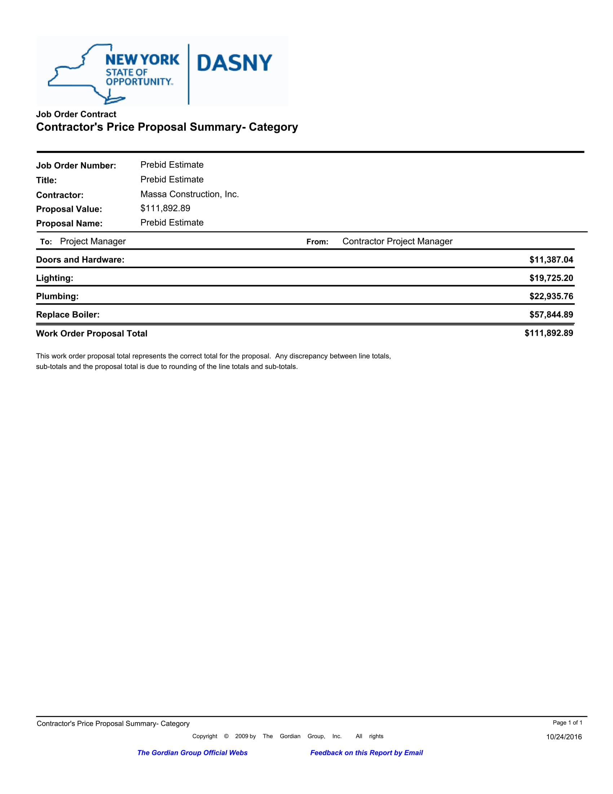
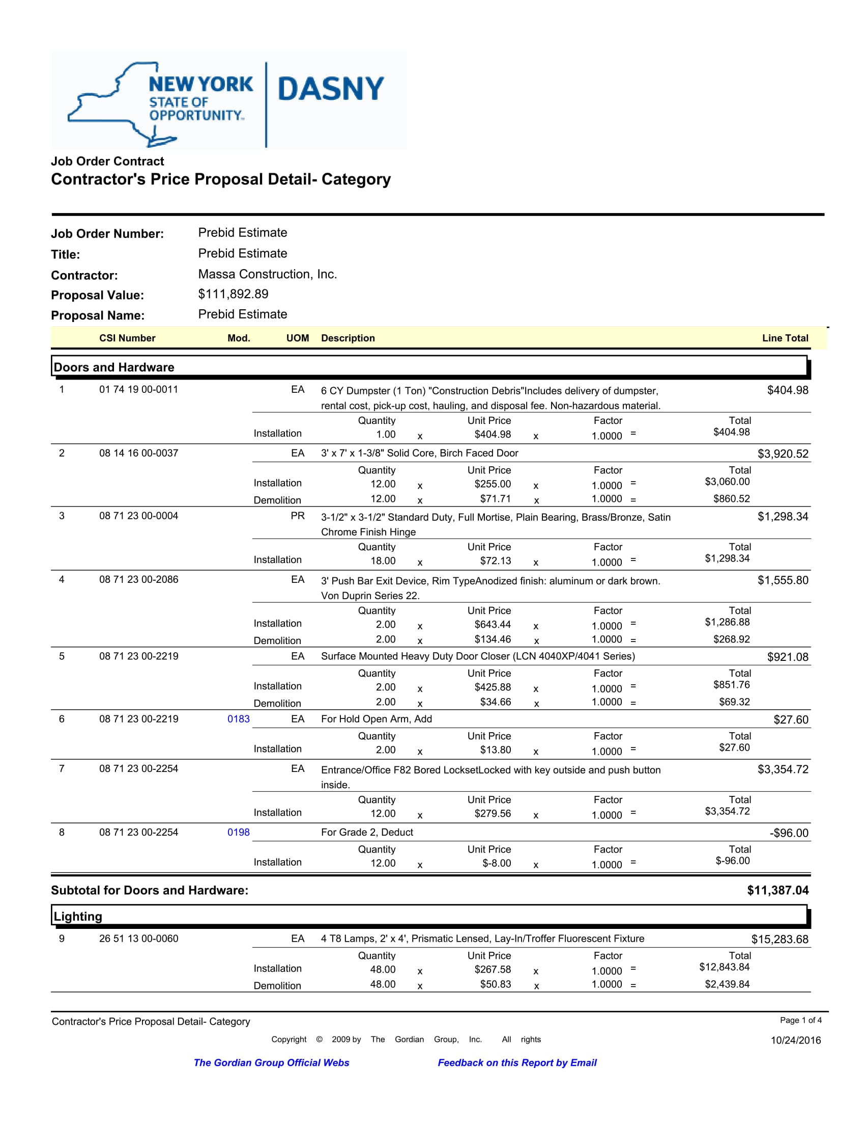
CALCULATING THE ADJUSTMENT FACTORS
Direct Cost of Work from CTC
Doors and Hardware $ 11,387.04
Lighting $ 19,725.20
Plumbing $ 22,935.76
Replace Boiler $ 57,844.89
TOTAL = $111,892.89
Direct Cost of Work from Quotes or Estimates
Doors and Hardware $11,615.00
Lighting $ 19,093.00
Plumbing $ 22,524.00
Replace Boiler $ 56,738.00
TOTAL = $109,970.00

Slide 38
CALCULATING THE ADJUSTMENT FACTORS
Overhead Costs
Job Order Development
  Joint Scope Meetings
  Reviewing Detailed Scopes of Work
  Building Price Proposal Packages
Site Supervision and Management
Safety
Insurance
Vehicles
Home Office Support
Communications
Putting It All Together
Cost of Work Quotes or Estimates = $ 109,970.00
Overhead @ 10% = $ 10,997.00
Subtotal = $ 120,967.00
Profit @ 5% = $ 6,048.35
Total = $ 127,015.35
Price Proposal from CTC® $ 111,892.89
$127,015.35/$111,892.89 = Adjustment Factor
Adjustment Factor = 1.1351

Slide 39

BID CONSIDERATIONS
High Quality of Work is Required
All Work Must Meet or Exceed DASNY Standards
Pay Higher Prices For:
  Better Quality
  Timely Completion
Cost of Supervising In-House Force, Subcontractors and Inspecting Work Before Completion
Prepare and Complete Your Own Punch list

Slide 40
BID CONSIDERATIONS
Minimum/Maximum Value
Number of Option Periods
JOC Contractor Performance
  Responsive Price Proposals
    Get to the Job Order Stage Quickly
  Demonstrated Performance
  High Quality, Timely Completion
  Cost Saving Price Proposals
Adjustment Factors are Good for the Life of the Contract
  - See General Conditions, Section 1A.04, Annual Update of the Construction Task Catalogs, D. & E.
What About Changes in Prices?
  Labor
  Equipment
  Materials
Construction Task Catalogs are Updated Annually
  - See General Conditions, Section 1A.04, Annual Update of the Construction Task Catalogs, A.

Slide 41


BID CONSIDERATIONS
Low Adjustment Factors
  May Lead to Disputes in Price Proposal Review
    Unsupportable Tasks
    Exaggerated Quantities
  May Lead to Delays in Job Order Development
    Takes Longer to Review Price Proposals
Creates an Adversarial Relationship
  Reduced Volume of Work
  No Option Periods
  Lost Profitability
No Change Orders to Improve the Margin
  - See General Conditions, Section 1A.04, Annual Update of the Construction Task Catalogs, A. & F.

Slide 42
MWBE and SDVOB Participation

Slide 43
MWBE and SDVOB Participation
MWBE / EEO/ SDVOB Requirements
DASNY’s Opportunity Programs Group (OPG) is responsible for ensuring DASNY’s compliance with all relevant sections of the Public Authorities Law, Set-Aside Legislation, and Article 15-A and Article 17-B of the Executive Law
Article 15-A of the NYS Executive Law , requires participation by minority group members and women with respect to state contracts. This requirement includes opportunities for minority- and women-owned business enterprises (MWBEs) and equal employment opportunities for minority group members and women (EEO)
Article 17-B of the NYS Executive Law, The Service-Disabled Veteran-Owned Business Act, signed into law by Governor Andrew M. Cuomo on May 12, 2014, provides for more meaningful participation in public procurement by Service-Disabled Veteran-Owned Businesses (SDVOBs)

Slide 44
MWBE and SDVOB Participation
MWBE / EEO/ SDVOB Requirements
DASNY’s Small Business, Minority and Woman-Owned Business Enterprise Pilot Program
  Enacted by the NYS Legislature in 2019
  Authorized DASNY to establish a four-year pilot program to contract for good and services from MWBE and Small Businesses (as defined by the Economic Development Law)
  SDVOBs counted as Small Businesses
  DASNY has sole authority to designate procurements under the program
  Procurements contracts may include construction and renovation of facilities
  Total value of contracts awarded under the Pilot Program cannot exceed $20 million or five percent of the value of all contracts awarded in a given fiscal year

Slide 45
MWBE and SDVOB Participation
JOC MWBE / SDVOB Compliance Guidelines
MWBE and SDVOB compliance is evaluated over the term of a JOC contract
Contractors are encouraged to include participation on each Job Order Issued
Contractors must maintain a record of their good faith outreach efforts for each job order issued
Contractors are encouraged to identify and periodically update a team of MWBE and SDVOB subs and suppliers
Contractors may request assistance from DASNY for referrals of MWBE and SDVOB firms
Contractors may subcontract all or substantially all of work required in a Job Order to a qualified MWBE or SDVOB firm to increase participation

Slide 46
MWBE and SDVOB Participation
JOC Goal Requirements – Downstate
Description | Region(s) | CR # | MBE Goal % of Total Contract | WBE Goal % of Total Contract | EEO Goal % of Total Workforce | SDVOB Goal % Total of the Contract
General Construction | 1 | 503 | 18 % | 12 % | 45% | 6 %
Mechanical | 1 | 506 | 18 % | 12 % | 45% | 6 %
General Construction | 2 | 504 | 18 % | 12 % | 25% | 6 %
Mechanical | 2 | 507 | 18 % | 12 % | 25% | 6 %
Asbestos Abatement | 2 | 508 | 18 % | 12 % | 25% | 6 %

Slide 47
MWBE and SDVOB Participation
JOC Goal Requirements – Upstate
Description | Region(s) | CR # | MBE Goal % of Total Contract | WBE Goal % of Total Contract | EEO Goal % of Total Workforce | SDVOB Goal % Total of the Contract
Plumbing | 3 | 505 | 18 % | 12 % | 25% | 6 %
General Construction | 5 & 6 | 509 | 18 % | 12 % | 8% | 6 %
General Construction | 7 | 510 | 18 % | 12 % | 8% | 6 %
Electrical | 10 | 511 | 18 % | 12 % | 14% | 6 %
General Construction | 10 | 512 | 18 % | 12 % | 14% | 6 %

Slide 48
MWBE and SDVOB Participation
Compliance Requirements
The JOC Contractor shall submit the following, as referenced in the Contract Documents, within the specified timeframes:
(Refer to the General Conditions Article 20 – Opportunity Programs, section 20.03 for submittal requirements)
Utilization Plan Submitted via Statewide Utilization Management Plan(SUMP)
Utilization Plan Cover Sheet (after the Utilization Plan is approved)
Standard Equal Employment Opportunity Policy Statement
Permanent Employee Distribution
Scope Verification Form
Monthly Workforce Utilization Report

Slide 49
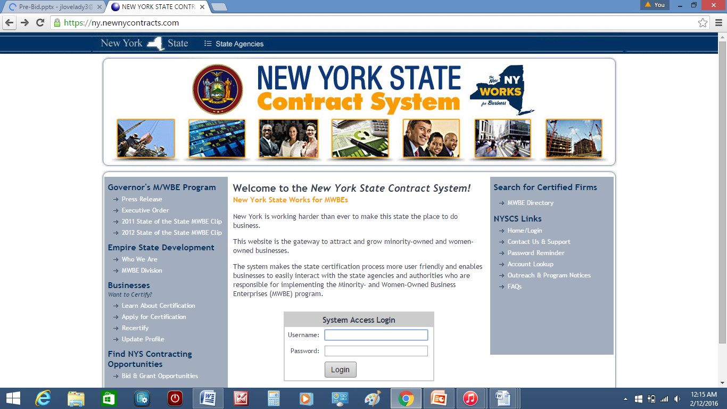
MWBE and SDVOB Participation
MWBE & SDVOB Payment Reporting
Effective January 1, 2014, prime contractors holding a DASNY contract are required to use the NYS Contract System to report all subcontractor and supplier payments for contract payments received from DASNY. Go to: https://ny.newnycontracts.com/

Slide 50
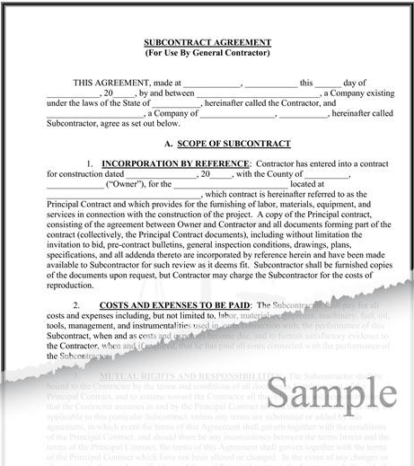
MWBE and SDVOB Participation
A copy of the executed subcontract agreement, purchase order, or letter of intent for each MWBE & SDVOB firm included in the approved Plan is required.
Submit documentation to:
Sabrina Stanback-Weeks
OPG Analyst (Downstate)
One Penn Plaza, 52nd Floor
New York, NY 10119
sstanbac@dasny.org
Submit documentation to:
Wendy Lossi
OPG Analyst (Upstate)
515 Broadway
Albany, NY 12207
wlossi@dasny.org

Slide 51
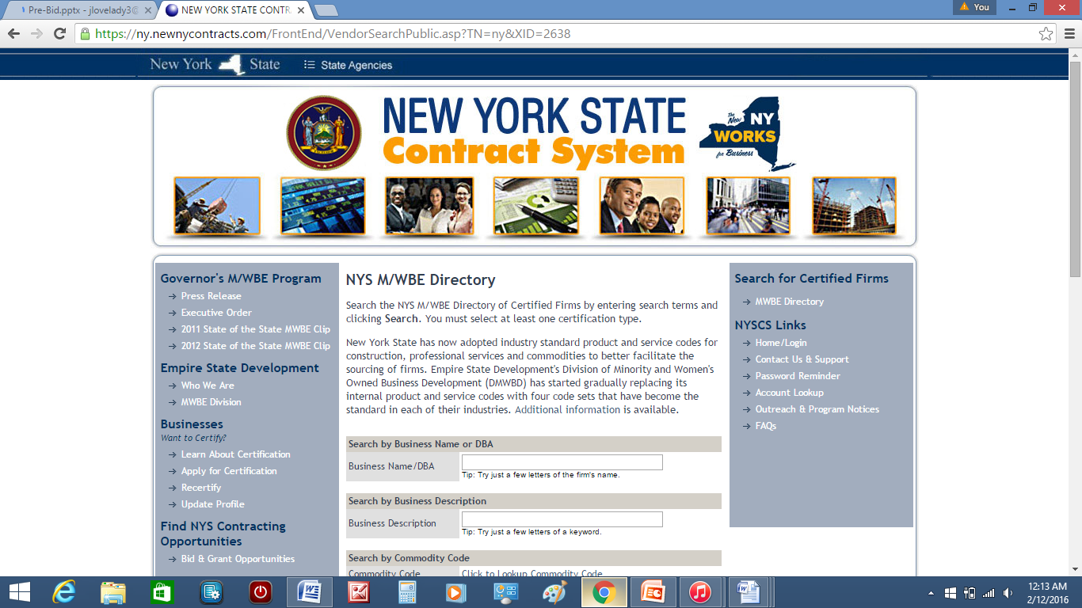
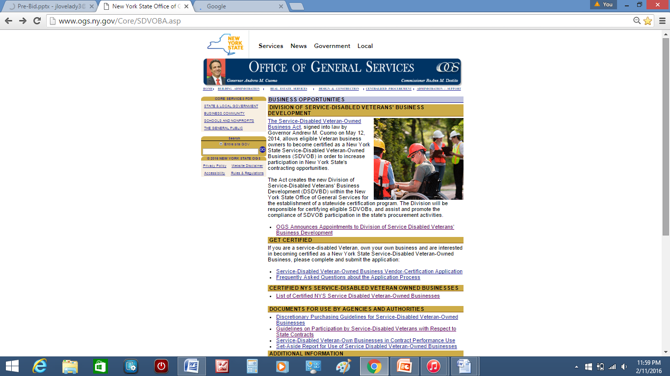
MWBE and SDVOB Participation
Finding NYS Certified SDVOBs
Finding NYS Certified MWBEs
  Explore the online Directory of NYS Certified SDVOB firms at: www.ogs.ny.gov/Core/SDVOBA.asp
  Explore the online Directory of NYS Certified MWBE firms at: https://ny.newnycontracts.com

Slide 52
MWBE and SDVOB Participation
What if my firm does not meet the goals by the end of the contract term?
Firm may submit a waiver request to DASNY OPG Upstate or Downstate Analyst
Waiver requests must provide a justification of any participation shortfall
Waiver requests must be supported by copies of good faith outreach efforts for all job orders issued
Refer to General Conditions Article 20 – Section 20.04 for Good Faith Efforts submittal requirements
DASNY OPG Analyst will review waiver request and coordinate with DASNY OPG Management concerning approval or denial
Failure to satisfy goals will result in a finding of non-compliance, the imposition of liquidated damages and potential exclusion from future DASNY contracts

Slide 53

DASNY Contacts
Opportunity Programs Group
Michael M. Clay, Senior Director
Thomas Christian, Assistant Director – Upstate
Leticia Negron, Assistant Director - Downstate
Job Order Contracting Program
Matthew Moore, Director
Wayne A. Benjamin, Chief
Christopher Enzien, Senior Project Manager

Slide 54





REVIEW of KEY POINTS
Understand How to Price Projects From CTC®
Know the Value of CTC®
Evaluate Risk of an Unrealistically Low Bid
JOC is a Long Term Relationship
Volume Driven by the JOC Contractor
  Put the Right Staff in Place
  Good Price Proposals
  High Quality Construction
  Timely Completion
  Meeting DASNY’s Expectations
  Solve Problems, Do Not Create Them

Slide 55
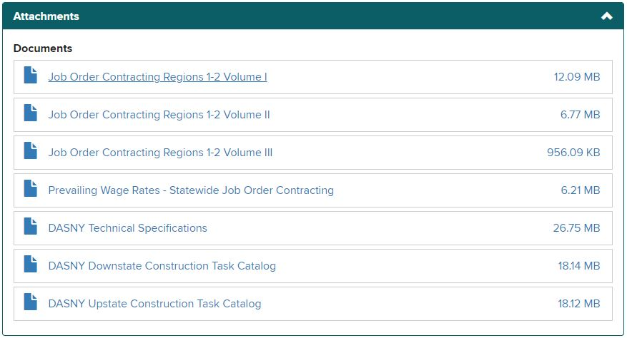
REVIEW of KEY POINTS
HOW TO OBTAIN CONTRACT DOCUMENTS
Available at no cost to bidders following Pre-Bid Conferences:
Regional Documents Contain:
  Bid Forms for Region 1
  Bid Forms for Region 2
  Bid Forms for Region 3
  Bid Forms for Region 5 & 6
  Bid Forms for Region 7
  Bid Forms for Region 10
Please see DASNY website for Documents at:
  https://www.dasny.org/opportunities

Slide 56
REVIEW of KEY POINTS
QUESTIONS REGARDING BID DOCUMENTS
After today’s Pre-Bid Meeting all questions must be submitted in writing to an Authorized Contact:
    Chris Enzien, Sr. Project Manager cenzien@dasny.org
    Construction Contracts at ccontracts@dasny.org
Bid Results:
  Bid results can be viewed at the DASNY website: http://www.dasny.org, 48 hours after the Bid Opening

Slide 57
QUESTIONS & ANSWER SESSION

