Slide 1
University at Buffalo,
State University of New York
New Residence Hall
Request for Proposals
RFP #5559
Pre-Proposal Meeting
March 24, 2020

Slide 2
March 24, 2020
Agenda
Presenter Introductions
Overview of UB’s Physical Comprehensive Plan
General RFP Requirements
Project Information
Technical and Cost Proposals
Selection and Evaluation of Proposals
Submission of Proposals
Questions

Slide 3
March 24, 2020
Presenter Introductions
Jackie McGovern, DASNY Senior Contract Administrator
Kelly Hayes McAlonie, UB Director of Campus Planning
Thomas Tiberi, UB Director of Campus Living
Tracy Conhiser-Uy, DASNY Architect and Design Project Manager
Rob Ryan, DASNY, Director, Construction & WNY Operations
Kim Smith, DASNY, Sr. Opportunity Programs Analyst

Slide 4
Comprehensive physical plan

Slide 5
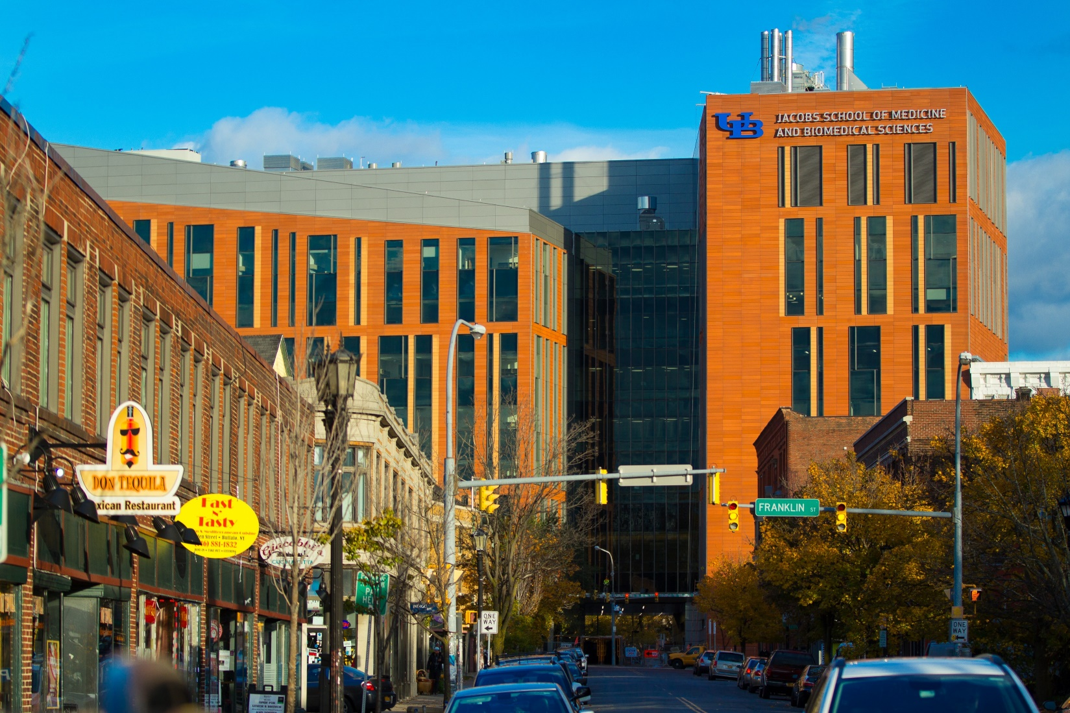
CREATE
Downtown Campus by moving the JSMBS from South Campus

Slide 6
REVITALIZE South Campus as a Professional Education Campus
Move The School of Social Work (SW) and Graduate School of Education (GSE)
Address space needs of growing schools
Demolish temporary and vacant buildings

Slide 7
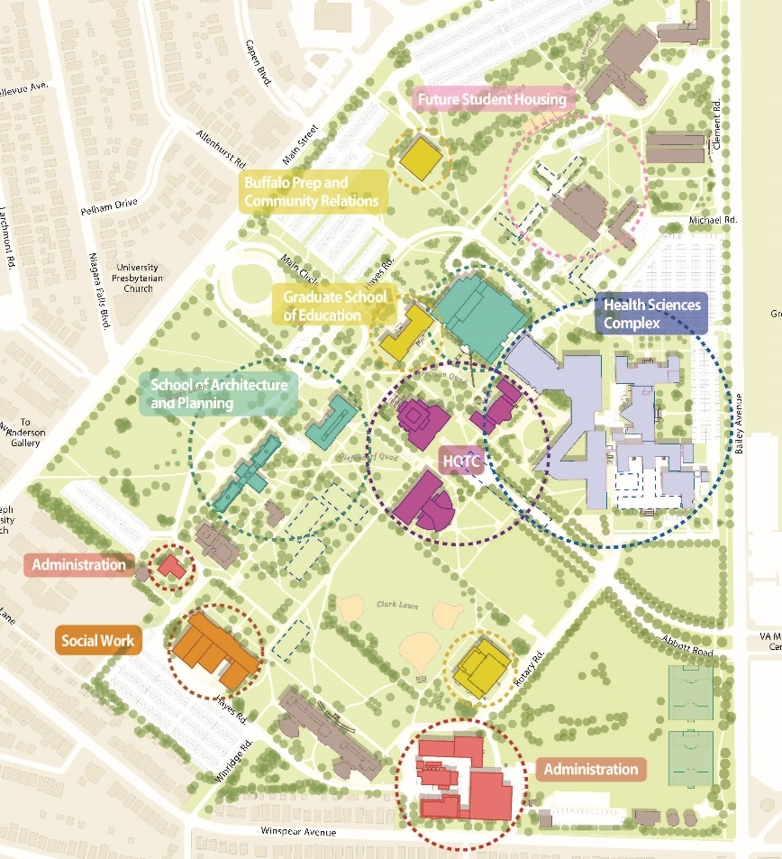
Programmatic Alignments
Move Graduate School of Education
Relocate School of Social Work to Parker Hall
Consolidate School of Public Health and Health Professions
Consolidate School of Dental Medicine
Improve School of Architecture & Planning facilities
Create vibrant Heart of the Campus: library, classrooms, university services and recreation facilities

Slide 8
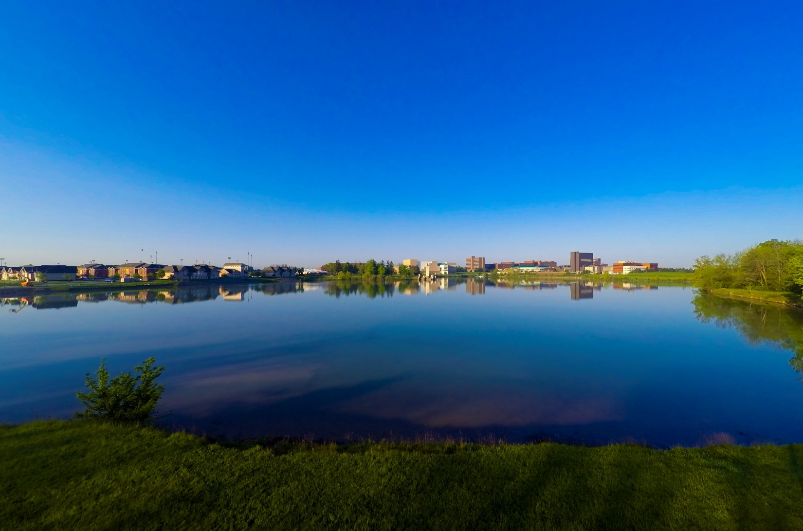
REIMAGINE North Campus as an Undergraduate and Research Center
Address academic and research space needs of growing STEM programs in particular for the School of Engineering & Applied Sciences and the College of Arts & Sciences
Increase centrally scheduled classrooms across campus

Slide 9
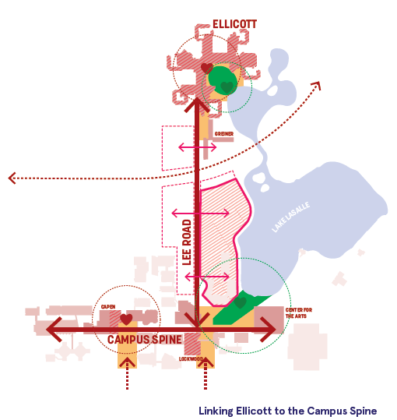
Strengthen the Spine
Connect the Spine to Ellicott
Enhance Lake LaSalle Experience

Slide 10
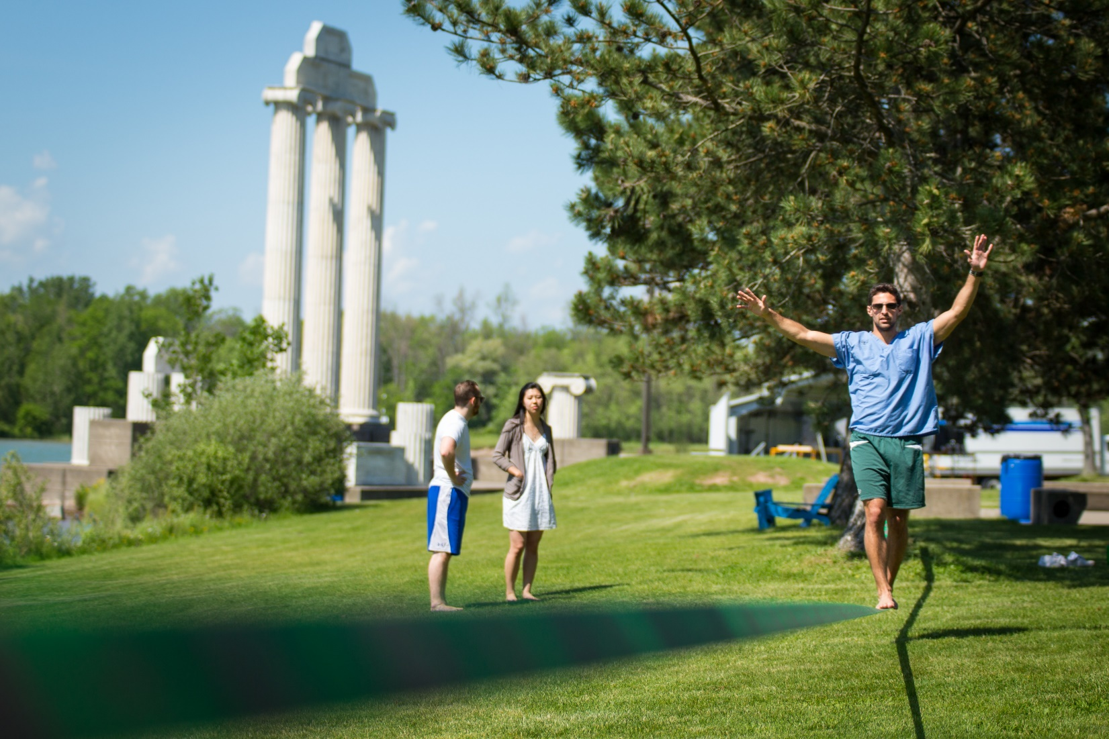
IMPROVE the campus life experience at all three centers
Create Heart of the Campus centers
Improve library and student experiences
Enhance/create recreation options

Slide 11
REDUCE deferred maintenance and address priority infrastructure
Align deferred maintenance needs with strategic projects

Slide 12
March 24, 2020
University at Buffalo
Climate Action Plan Carbon Reduction Strategies:
Implement a phased carbon pricing system across the university
Source 100% of electricity from renewable sources by 2025
Electrify 100% of the University’s fleet vehicles
Establish a zero carbon heating and cooling strategy for North, South and Downtown Central Plants
Achieve zero waste across all university material streams
Attain a 30% reduction in building energy use through conservation measures
Create zero carbon commuting pathways for student, faculty and staff
Quantify the carbon impact of our university’s food system by 2021 and set goals to half that by 2030
Purchase offsets to achieve climate neutrality with greatest local impact
Craft cutting-edge climate action analysis metrics and continuous improvement system

Slide 13
March 24, 2020
University at Buffalo
Campus Living
VISION To be the Benchmark for a World Class Student Housing Program
MISSION Inclusive Residential Communities,
Personal Growth and Learning,
Every Day for Every One.
VALUES Inclusion: Creating a community that welcomes and celebrates every student, staff and guest with all of their diverse identities, beliefs and ways of thinking.
Learning: Cultivating an environment for all students and staff to expand their knowledge through exploration and engagement.
Safety: Foster an environment that protects the community’s physical, personal (psychological, sociological), technological and economic well-being.
Integrity: Demonstrating honesty, reliability, trustworthiness and ethical behavior in all we do.

Slide 14
March 24, 2020
Sustainability
DASNY LEED Silver minimum
SUNY Program Directive 1B-2 Net Zero Carbon Buildings
Net-Zero Energy Ready (NZER) Building
University at Buffalo
Focus on health, well-being, culture and learning
Support the Climate Action Plan and Campus Living vision, mission and values
Additional guidance and rating systems; Fitwell, WELL, Passive House, Living Building Challenge, in full or in principal.

Slide 15
March 24, 2020
Scope of Work
600-bed dormitory with first floor mixed use. Located on UB’s North Campus in Amherst
Consultant will be required to work with Construction Manager at Risk/CM Build and produce early foundation/site utility package.
A programming report will be provided to the successful project team. The program document will address key project scope such as confirmation of exact bed count, bed type mix, RA ratios and amenity spaces. The document will establish objectives for environmental and resilient design, as well as requirements for academic or commercial program spaces.
Integrated Design Process throughout the project, including implementation of the Owners Project Requirement (OPR) document, and recommended Basis Of Design (BOD) documentation to be updated at each phase of the work.
Use of innovative design to achieve the highest building performance.
Requirements for a human-centered, healthy, comfortable, flexible, and supportive environment for the occupants, which creates a sense of belonging in the overall campus community.

Slide 16
March 24, 2020
Scope of Work
Performance Modeling to inform design and budget, supplemented by Energy Modeling to refine energy performance and provide predictive information on energy use and energy cost, reflecting on established EUI targets.
Student occupancy is required for the start of the Fall 2023 semester (Construction completion 7/2023).
Incorporation of DASNY and SUNY sustainability requirements.
Identification and employment of sustainability program(s) that supports UB’s strategies, mission, value and vision.
The requirement is for the project to be Net Zero Carbon. Additionally, the building shall be ready with the infrastructure needed to achieve Net Zero Energy building performance. This NZER performance will be achieved by a future separate Owner addition of renewable energy systems on-site.

Slide 17
March 24, 2020
Scope of Work
Post Occupancy Evaluation period engagement for up to one year’s duration with the intent of:
Confirming energy and usability performance goals
Implementing reasonable adjustments for performance improvements
Developing case studies and lessons learned documents to share
Refining the ZNC-ready solution to strengthen its replicability as an approach for future projects

Slide 18
March 24, 2020
Scope of Work
Specific Energy goals include:
Design and construct a highly energy efficient building with significantly reduced energy consumption, below the energy code standard for new buildings.
The project, at initial occupancy, shall be NZC + NZER; any energy use can be offset on a net annual basis by the future installation of on-site renewable energy.
Design must incorporate a zero carbon heating and cooling strategy.
The project intends to meet a site Energy Use Intensity (EUI) of 31 kBTU/SF/Year or less.

Slide 19
March 24, 2020
Scope of Work
Other goals include:
Community: the project shall consider the uniqueness of the University at Buffalo community, it’s students and its student residence and will foster a positive, sensitive atmosphere and value academic success.
Adaptability: the project shall consider the needs of its future residents, and the necessary adaptability of the facility to accommodate these changing requirements.
Teaching tool: the project shall consider opportunities to utilize the facility as a teaching tool, showcasing and exemplifying sustainability as part of the University’s Sustainable Development Goals.
Focus on health, well-being, culture and learning for the occupants of the building.
Indoor Air Quality and Materials: As NZEB goal achievement requires a tight building envelope and highly controlled ventilation, it is imperative to reduce the toxins in building materials and to design the building to enhance indoor air quality. Project shall focus on air quality goals and maintenance of air quality in operations.
Construction Waste reduction: The SUNY system has a Zero Waste Goal and this project requires a minimum diversion rate of 75% (by volume or weight) of total construction and demolition, non-hazardous material through recycle, reuse, and/or salvage.

Slide 20
March 24, 2020
Scope of Work
Additional Considerations:
NYSERDA’s New Commercial Construction Program
Building to be sensitive to the principals of Universal Design
DASNY submission requirements are outlined in the RFP and sample contracts
SEQRA:
DASNY’s Office of Environmental Affairs will conduct SEQRA review with support from Design Professional
Permitting:
Construction Permitting Agency - DASNY

Slide 21
March 24, 2020
Budget and Schedule
Estimated Construction Budget $73,000,000
Schedule
Issuance of RFP 03/05/2020
Pre-Proposal Meeting 03/24/2020 (3:00 PM)
Deadline for RFP Questions 03/27/2020 (5:00 PM)
Post Responses to RFP Questions 04/01/2020
Proposal Due Date 04/09/2020 (5:00 PM)
Interviews/Presentations (no earlier than) 05/07/2020
Notice of Award (no earlier than) 05/21/2020

Slide 22
March 24, 2020
Qualifications
The Design Team shall have recent experience within the past 10 years, in designing and constructing residence halls, or other institutional buildings, that are similar in size, scope, schedule duration, and/or complexity;
The Design Team shall have a demonstrated history of successful collaboration and design innovation in constructing complex facilities using engineering/procurement/construction (“EPC”) methodologies and integrative processes;
The Design Team or team members shall have a demonstrated history of work on low-energy buildings and/or buildings achieving a high-performing certificate such as Net Zero and/or Net Zero Ready Buildings, LEED, Passive House, and Living Building Challenge, or other sustainability programs. Demonstrated expertise in Building Science and use of low-carbon materials is of value;
Experience with CM at Risk/CM Build project delivery methodology;
Project estimating capabilities; and
An established and verified QA/QC Program.

Slide 23
March 24, 2020
Technical Proposal
Tab 1 Cover Letter
Tab 2 Project Team
Tab 3 Project Experience
Tab 4 Project Approach and Schedule
Tab 5 Utilization Plan
Tab 6 Diversity Questionnaire
Tab 7 SDVOB Business Plan
Tab 8 Certificates
Tab 9 W-9 Form
Tab 10 Additional Information

Slide 24
March 24, 2020
Cost Proposal
Tab 1 Cover Letter
Tab 2 Man/Womanpower and Costs
Tab 3 Overhead and Profit Multiplier
Tab 4 Classification & Rate Form
Tab 5 Insurance Certificate

Slide 25
March 24, 2020
Additional Forms
Provide the following forms loosely:
Complete the NYS Vendor Responsibility Questionnaire online and submit a copy of the certification page
Completed Procurement Lobbying Law Certification

Slide 26
March 24, 2020
Selection and Evaluation of Proposals
Incomplete proposals may be rejected.
Evaluation will be conducted by a Committee selected by DASNY.
Criteria for selection shall be the qualifications required by Section 2 and Section 3 of the RFP.
DASNY may request some or all of the firms submitting proposals to provide a presentation of their proposal.

Slide 27
March 24, 2020
Submission of Technical and Cost Proposal
Technical Proposal:
Seven double-sided hard copies
One electronic copy in PDF format (thumb drive media only)
Cost Proposal
Seven double-sided hard copies
One electronic copy in PDF format (thumb drive media only)

Slide 28
March 24, 2020
Reminders
Please submit all written questions by March 27, 2020 at 5:00PM to:
Christine Ostrander
Email: RFPCoordinator@dasny.org
Post Responses to RFP Questions 04/01/2020
Proposal Due Date 04/09/2020 (5:00 PM)
Interviews/Presentations (no earlier than) 05/07/2020
Notice of Award (no earlier than) 05/21/2020

Slide 29
University at Buffalo,
State University of New York
New Residence Hall
Request for Proposals
RFP #5559
Questions?

