Slide 1
Opportunity Programs Group
General Contractor Community Minor Maintenance Program (GC-CMM)
March 3, 2020

Slide 2
Region Breakdown

Slide 3
About DASNY’s Community Minor Maintenance Program (CMM)
CMM was established in 2011 at the request of the New York State Department of Mental Hygiene (DMH) - Office of Mental Health (OMH), Office for People with Developmental Disabilities (OPWDD) & Office of Addiction Services and Supports (OASAS)
CMM undertakes smaller construction projects located throughout the State of New York for both DMH and the State University of New York (SUNY)
Projects generally have a single scope of work and range in construction value from $10,000 - $80,000
Work generally consists of exterior work, including roof replacement, driveway replacement, and renovations or replacement of exterior decks, windows, stairways, and entrances
Interior renovations such as kitchen and bathroom rehabilitation, painting and flooring replacement may also be undertaken under the CMM Program

Slide 4
Options for Performing Work Under CMM
Work under CMM may be performed through either a Job Order Contract (JOC) contractor or a General Contractor Community Minor Maintenance (GC-CMM) contractor
GC-CMM method provides a more expedited contracting process and cost-effective method of managing and supervising the work

Slide 5
The GC-CMM Contracting Method
GC-CMM contracts:
Based upon an agreed upon mark-up percentage
Term of two years, with a two year option
$80,000 dollar cap on each individual work order
$80,000 cap excludes the general contractor’s agreed upon mark-up percentage

Slide 6
About The Mark-up Percentage
Mark-up percentage covers GC’s cost for:
Supervising and coordinating work
Overhead and profit
Insurances
GC applies the mark-up to any sub-contractor performing work on a CMM Program project

Slide 7
Services Provided by GC under CMM Contracts
Services provided by GC for each work order include but are not limited to:
Investigation and Planning
Bidding and Pre-Construction
Construction Management
Supervision and Coordination
Close-out

Slide 8
GC’s General Responsibilities
Obtain at least three price quotes for the scope of work for each work authorization issued
Perform all work required using subcontractor unless otherwise approved by DASNY
Obtain written approval from DASNY before self-performing any work
Perform incidental portions of the scope of work such as custodial services or using GC’s own work force, as directed by DASNY

Slide 9
Compliance and Reporting Requirements
Satisfy MWBE goals assigned to GC-CMM contract on each work order issued
May solicit NYS Certified M/WBEs only for a specific scope of work
Pay subcontractors and suppliers within 10 days of receiving payment from DASNY
Report payments made to subcontractors and suppliers in the New York State Contract System (NYSCS)
Require subs and suppliers to confirm in the NYSCS the payments reported by GC
Provide DASNY with monthly EEO/Workforce utilization reports

Slide 10
March 3, 2020
CMM Goal Requirements
MBE
18%
WBE
12%
SDVOB
6%
EEO
10% Upstate
45% Downstate
CMM must achieve the required MWBE participation goals over the term of their contract
CMM should engage subcontractor/supplier participation on every job order to ensure that the contractually required MWBE goals are met before expiration of the contract

Slide 11
March 3, 2020
ber 12, 2016
OPG Reporting
Initial Utilization Plan Through the Statewide Utilization Management Plan (SUMP)
Subcontractor Award Documentation
NYS Contract System subcontractor/supplier payment reporting
EEO Reports

Slide 12
EEO Report - Form 162

Slide 13
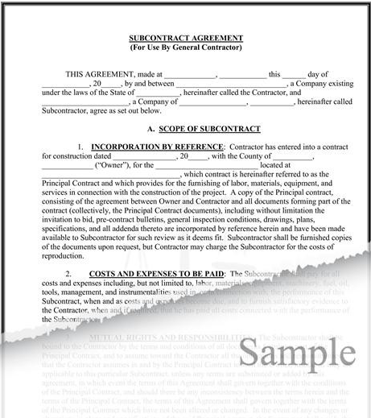
March 3, 2020
12, 2016
MWBE Subcontract Agreement
Forward a copy of the signed Subcontract Agreement between the Prime and MWBE to DASNY’s Opportunity Programs Group.
(i.e. executed subcontract agreement, purchase order or letter of intent)
Email documentation to:
Kimberly D. Smith
Sr. Opportunity Programs Analyst
Construction / Opportunity Programs
KSmith@DASNY.org

Slide 14
March 3, 2020
MWBE Payment Reporting
Effective January 1, 2014, all prime contractors holding a DASNY contract are required to use the NYS Contract System to report all subcontractor and supplier payments for contract payments received from DASNY.
Go to: https://ny.newnycontracts.com/
Locate your company’s account
Authorize users for your company
*Please authorize the staff responsible for
confirming payment information for your firm.
Review and Respond to the audits
Report all MWBE subcontractor/supplier
payments to receive proper utilization credit.

Slide 15
March 3, 2020
EEO Reporting
Forward a copy of the EEO Reports to:
opgworkforcereporting@dasny.org

Slide 16
March 3, 2020
ober 12, 2016
Finding N.Y.S. Certified MWBEs/SDVOBs
Explore the Online Directory of NYS Certified firms
https://ny.newnycontracts.com/
http://online.ogs.ny.gov/SDVOB/search
Build a working relationship
Contact the Opportunity Programs Group:
Upstate – Kim Kreski
518-257-3706 or kkreski@dasny.org
Downstate - Charles Croskey
212-273-5115 or ccroskey@dasny.org

Slide 17
March 3, 2020
,
What if my firm does not meet the MWBE goals?
Your firm is encouraged to make a Good Faith Effort to engage subcontractor/supplier participation on every job order.
Failure to meet the goals will result in a finding of non-compliance resulting in sanctions and exclusion from future contracts with DASNY.
Request for MWBE waivers at the end of the contract are not acceptable.
All MWBE waiver requests must be forwarded to the OPG Analyst
“Good Faith Efforts” documentation will be required

Slide 18
March 3, 2020
Opportunity Programs Group
Michael M. Clay
Sr. Director OPG, Co-Leader of Procurement
518-257-3464
Kimberly D. Smith
Sr. Opportunity Programs Analyst
Construction / Opportunity Programs
518-729-8095
Thomas Christian
Asst. Director Upstate Operations
518-257-3795
Charles Croskey, MWBE Business Development & Outreach Coordinator
212-273-5115

Slide 19
Questions regarding this Webinar
Email your questions to Dbyrnes@DASNY.org
Questions will be received through Friday, March 6th.
Q & A will be compiled and posted to DASNY.org with the GC CMM RFP

